Slide 1


What is AWS Organizations?
AWS Organizations is an account management service that enables you to consolidate multiple AWS accounts into an organization that you create and centrally manage

Slide 2
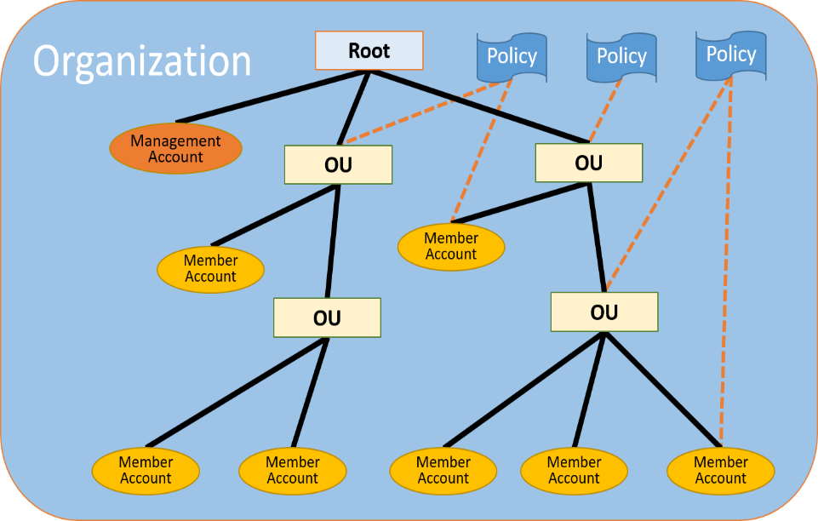

Slide 3
Consolidated billing
PAYING ACCOUNT
DEVELOPMENT ACCOUNT
TOTAL Monthly Bill Test = 1000$ Dev = 3000$ Prod = 800$ Total Bill = 4800$
PRODUCTION ACCOUNT
TEST ACCOUNT
All link account is independent
Paying Account is independent. Cannot access resource of the other accounts.
More you use, less you pay. Aggregate of all account

Slide 4

Advantages of Consolidated Billing
One bill per AWS account
Very Easy to track charges and allocate cost
Volume pricing discount

Slide 5
Some Best Practices with AWS Organizations
Always enable multi-factor authentication on root account
Always use a strong and complex password on root account
Paying account should be used for billing purposes only. Do not deploy resources into the paying account
Enable/Disable AWS services using Service Control Policies (SCP) either on OU or on individual Accounts

Slide 6
Thank you

